Slide 1

Sentiment Analysis of Hotel Reviews: A Machine Learning approach in Python
CIS 5850 - Communication and Information Services
Instructor : Ivan Pantaleon
Presented by:
Sapan Shah
Snehil Sarkar
Sai Sridhar Karri

Slide 2

Introduction to TripAdvisor and Hotel Review Data
1
TripAdvisor Platform
2
Hotel Review Data
TripAdvisor is a leading travel website, offering user-generated reviews and ratings for hotels, restaurants, and attractions.
Around 20k hotel reviews on TripAdvisor provide valuable insights into guest experiences, preferences, and overall satisfaction.
3
Data Structure
Hotel reviews are typically structured as text with a numerical rating, providing a rich source of information.

Slide 3

Collecting and Preprocessing the Data
1
Data Source
A free data source, Kaggle is used to extract hotel review data from TripAdvisor.
2
Data Cleaning
Cleaning the data involves removing irrelevant information, handling missing values, and standardizing formats.
3
Preprocessing
Preprocessing steps include tokenization, stemming, and stop word removal to prepare the text for analysis.

Slide 4

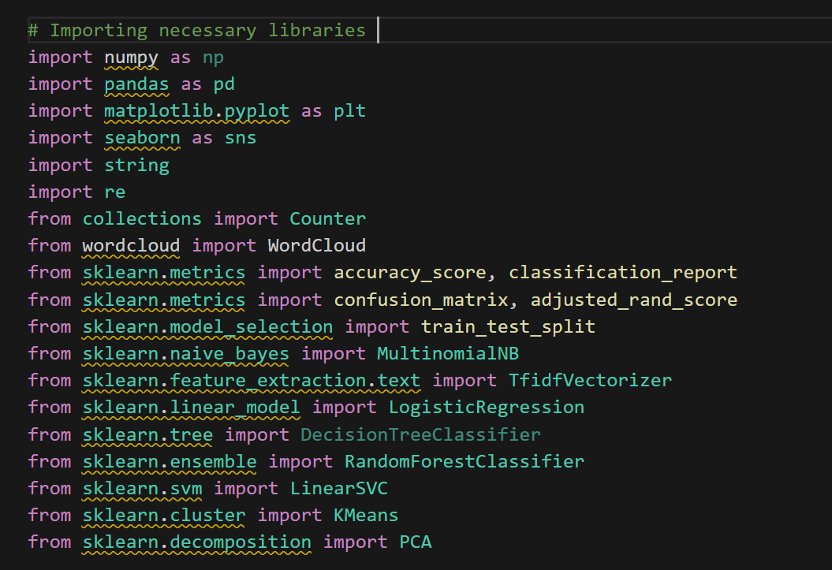
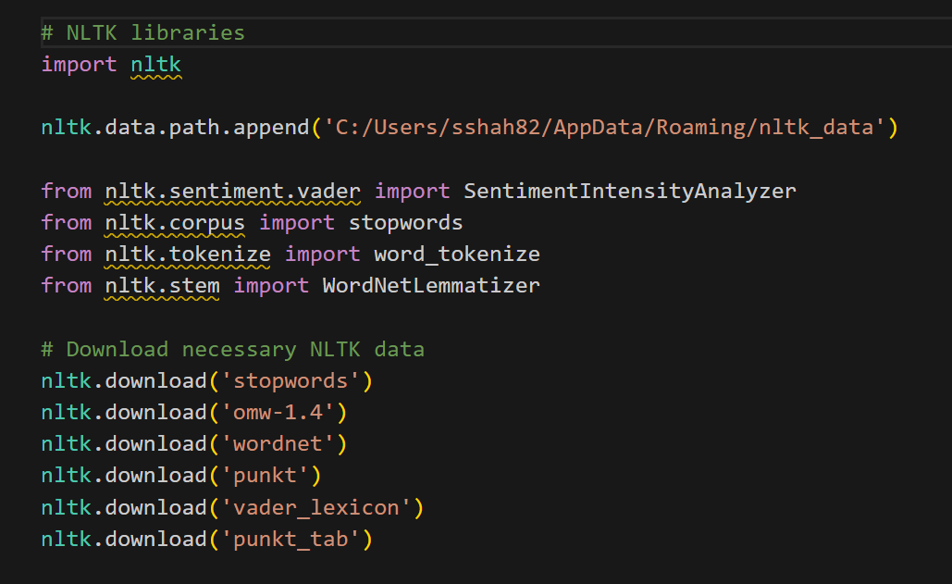
Operating System OS: Windows 10
Python Version: 3.12 (64-bit)
IDE
Visual Studio Code
Python Libraries used for data analysis
Pandas
Numpy
NLTK
Vader: Sentiment scoring.
Stopwords: Word filtering.
Lemmatizer: Text simplification
Python Libraries Used for Visualization
Matplotlib
Plotly
Seaborn
Technical
Information

Slide 5

Exploratory & Predictive Data Analysis
Exploratory Data Analysis (EDA)
Predictive Data Analysis
EDA uncovers patterns and relationships in data. It uses visual methods like histograms and scatter plots.
Predictive analysis forecasts future outcomes based on historical data. It uses statistical models and machine learning algorithms.
EDA is iterative and helps formulate hypotheses. It's crucial for understanding data distributions and identifying outliers.
This approach is used for decision-making and strategy planning. It requires clean, processed data from EDA.

Slide 6
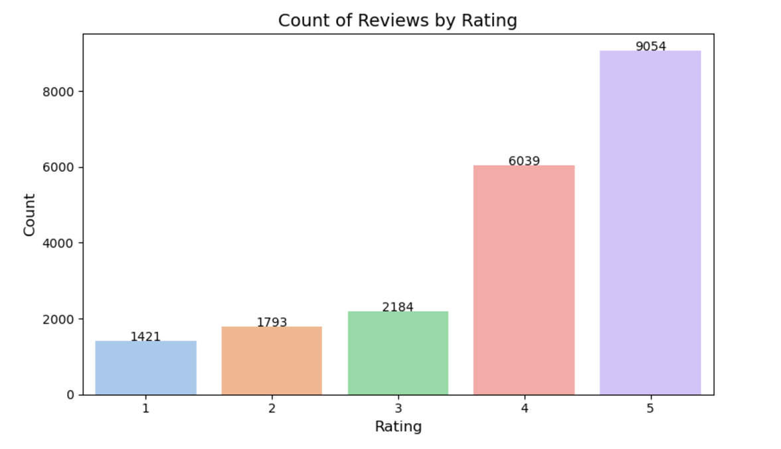
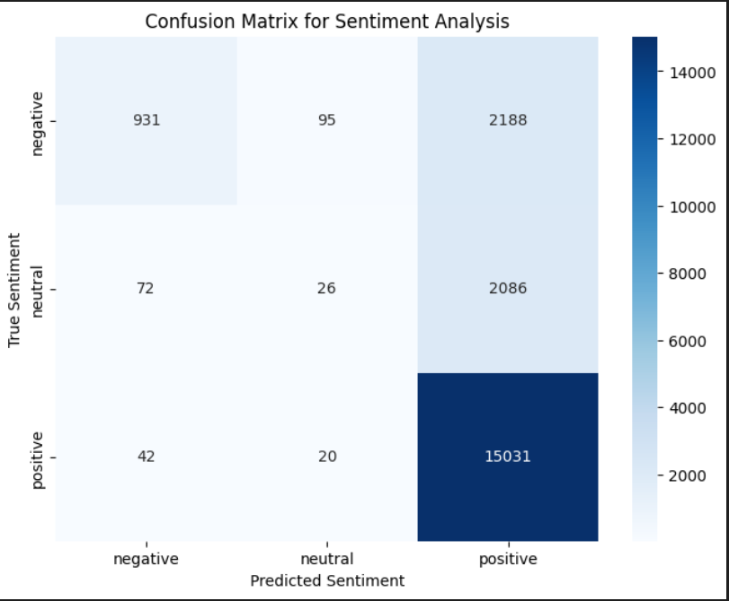
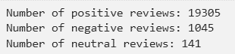
Exploratory Data Analysis (EDA)
Rating Distribution
Sentiment Analysis
Analyzing the distribution of hotel ratings helps understand overall guest satisfaction levels.
Sentiment analysis techniques are used to determine the overall tone and sentiment expressed in reviews.

Slide 7
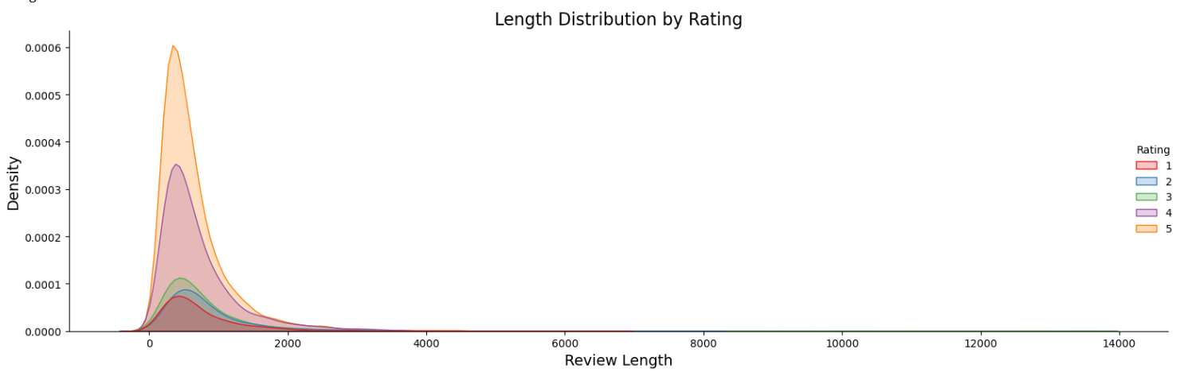

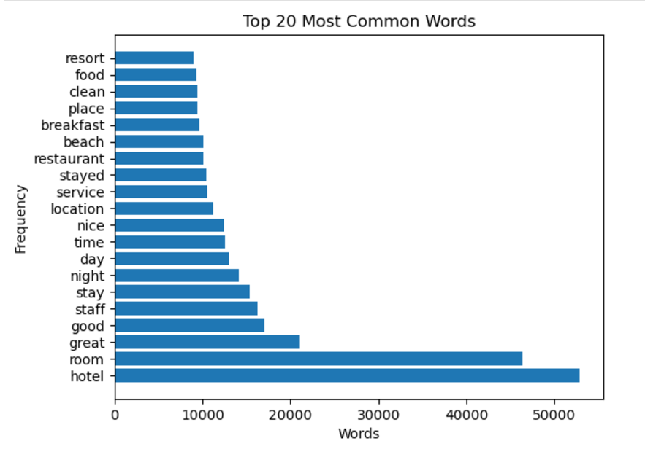
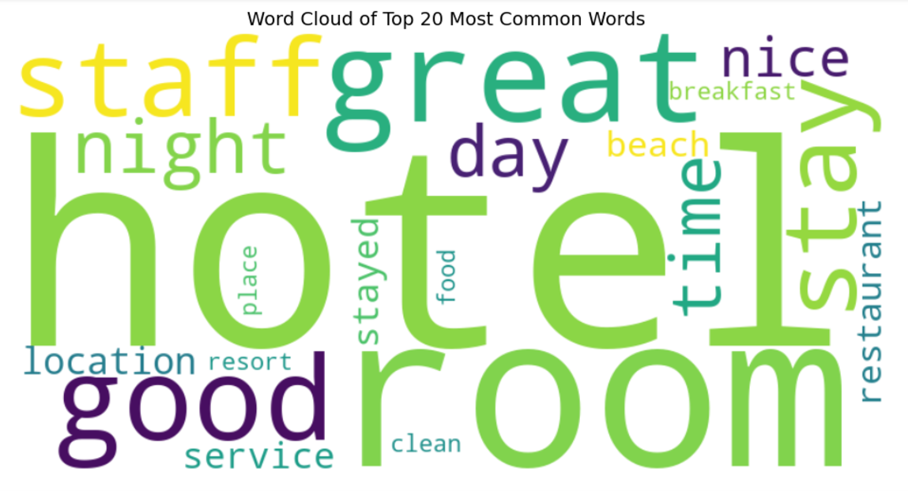
EDA
Continue..
Review Length
20 Most common words
Bar chart showing the frequency of the 20 most common words in the reviews, with "hotel" and "room" being the most frequent.
A visually appealing word cloud representing the most common words in the reviews, with larger words indicating higher frequency.

Slide 8


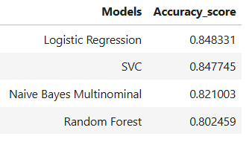



Implementing Machine Learning Models
Random Forest
A versatile ensemble method that uses multiple decision trees to improve classification or regression accuracy and prevent overfitting.
Naive Bayes Multinomial
A probabilistic model ideal for text classification or discrete data, assuming feature independence.
Logistic Regression
A statistical model that predicts class probabilities by fitting a linear boundary using the log-odds of the target variable.
Linear Support Vector Classification
A robust classifier that finds the optimal linear hyperplane to separate data points with maximum margin.

Slide 9

Evaluating Model Performance
Accuracy
Percentage of correctly predicted ratings.
Precision
Proportion of correctly predicted positive ratings.
Recall
Proportion of actual positive ratings correctly identified.
F1-Score
Harmonic mean of precision and recall.

Slide 10
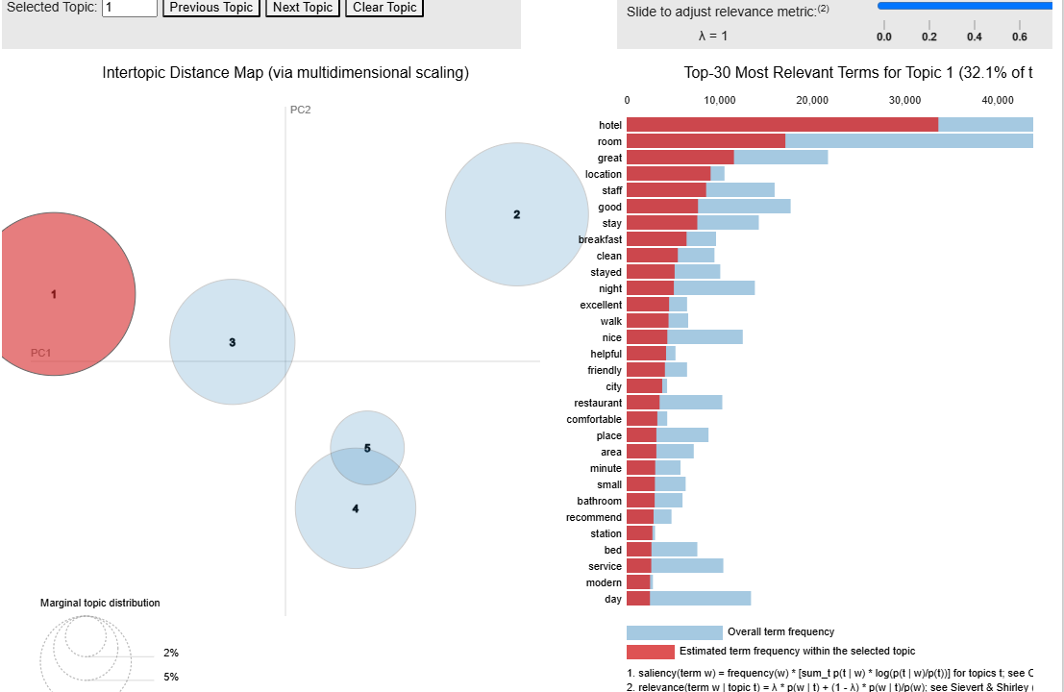
Topic Modeling
Objective:
The LDA (Latent Dirichlet Allocation) model identifies topics from the hotel reviews dataset, with key words representing the core themes of each topic. Here’s a breakdown of the topics based on their top words.
Model Setup:
Trained with 5 Topics
Output: Top words for each topic extracted.
Implications:
Identified themes provide deeper insights into sentiment analysis, help to improvise facilities, service enhancement and also create marketing opportunities.

Slide 11




Text Clustering for Negative Reviews
Grouped similar negative reviews (ratings ≤ 2) into clusters using K-means clustering.
Method:
Vectorization
Evaluation
Convert reviews to TF-IDF
vectors
Calculate adjusted Rand
index
Clustering
Analysis
Apply K-means algorithm
with 3 clusters
Identify top terms per cluster
Top terms for each cluster identified, revealing common themes in negative feedback.

Slide 12
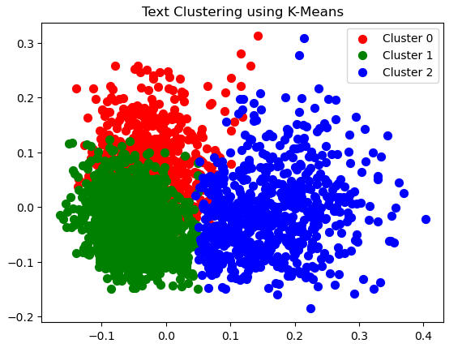
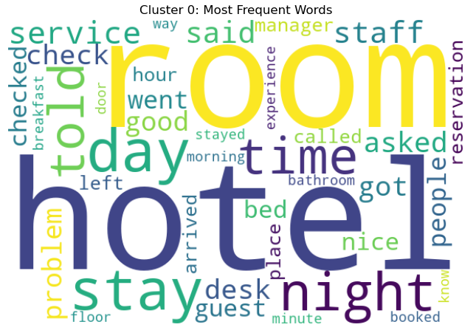
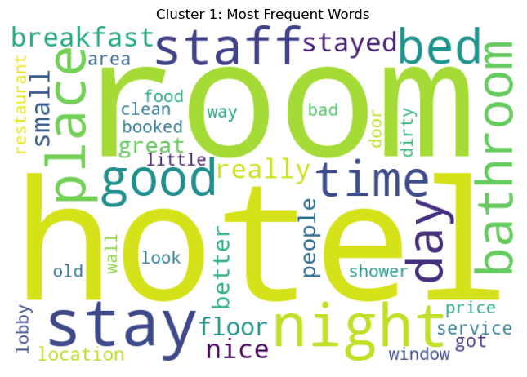
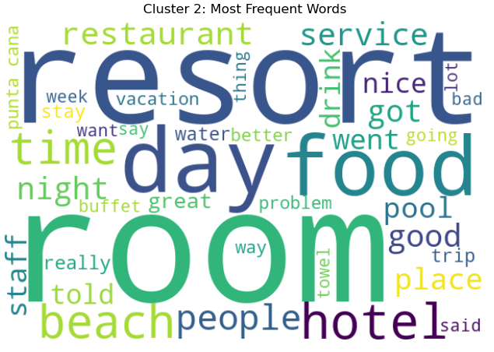
Visualization of Negative Review Clusters
Word clouds for each cluster highlight frequent words, revealing the main issues in negative feedback.
1
Dimensionality Reduction
Apply PCA to reduce TF-IDF vectors to 2D for
visualization
2
Scatter Plot
Create a 2D scatter plot of the negative review
Clusters.
3
Word Cloud Generation
Generate word clouds for each cluster to visualize frequent terms

Slide 13
BUSINESS USE CASES
Improved Customer Experience:
Analyze customer sentiments to identify recurring issues or highlights in reviews.This allows hotels to address negative feedback proactively and improve customer satisfaction.
Competitive Benchmarking:
Compare sentiment trends across competing hotels in the same region. Understand strengths and weaknesses relative to competitors to position the hotel better in the market.
Dynamic Pricing Strategies:
Identify patterns in guest satisfaction during high-demand or low-demand seasons. Use this information to adjust pricing strategies based on customer sentiment and perceived value.
Targeted Marketing Campaigns:
Use positive sentiments from reviews to craft effective marketing campaigns that highlight features customers’ preferences.
Enhanced Service Offerings:
Detect common areas of improvement or unmet guest expectations and tailor services or packages accordingly to enhance offerings.
Reputation Management:
Monitor and respond to reviews in real-time using sentiment insights. Use of machine learning models to prioritize addressing highly negative reviews, ensuring a more proactive approach to managing the hotel’s reputation online.

Slide 14
CONCLUSION
Achievements
Future Directions
This project demonstrated the power of machine learning techniques in analyzing hotel reviews.
Sentiment analysis achieved 78% accuracy, while rating prediction models reached up to 84.83% accuracy.
Topic modelling identifies 5 themes: General hotel features, Resort & Leisure Experience, Issues/service concerns, Guest experiences and Amenities & comfort.
Clustering of Negative reviews produce ARI score 0.019 which indicates clustering algorithm does not align well with original sentiment labels.
.
Improving model performance.
Incorporating more features.
Developing a real-time recommendation system for hotels based on review analysis.

Slide 15



https://github.com/sshah82/SentimentAnalysis_HotelReviews
THANK YOU
YouTube: Click Here
Dataset
https://www.kaggle.com/datasets/andrewmvd/trip-advisor-hotel-reviews

